Slide 1

Banner: An Image Sensor Reconfiguration Framework
for Seamless Resolution-based Tradeoffs
Jinhan Hu, Alexander Shearer, Saranya Rajagopalan, Robert LiKamWa
Arizona State University
Tempe, Arizona
jinhanhu,acshear1,srajag25,likamwa@asu.edu
Submitted by : KRISHNA KUMAR BAIS (241110038)
CS724: SENSING COMMUNICATIONS AND NETWORKING
FOR SMART WIRELESS DEVICES
Banner :An Image Sensor Reconfiguration Framework for Seamless Resolution-based Tradeoffs

Slide 2
Introduction
Banner is a media framework designed to make camera resolution changes smooth and quick.
High-resolution video drains battery quickly in mobile devices, but high detail isn’t always necessary.
Banner’s goal is to enable dynamic resolution switching to save energy while maintaining video quality.
Banner eliminates delays that typically disrupt video during resolution changes.
Banner :An Image Sensor Reconfiguration Framework for Seamless Resolution-based Tradeoffs

Slide 3
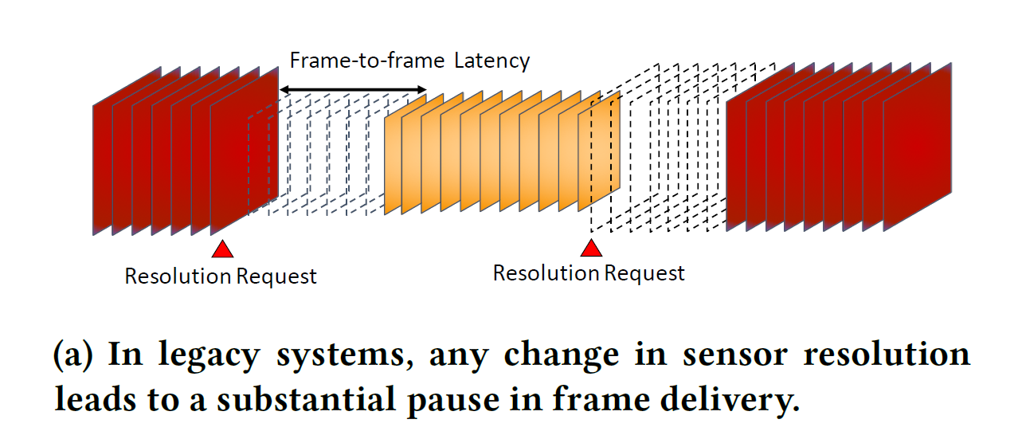
Problem Statement
High-resolution video capture provides detail but uses a lot of energy.
Switching camera resolution in current systems causes up to 280 ms delay.
This delay results in frame drops and reduces real-time video performance.
The delay blocks potential energy savings by preventing flexible resolution changes.
Banner :An Image Sensor Reconfiguration Framework for Seamless Resolution-based Tradeoffs

Slide 4
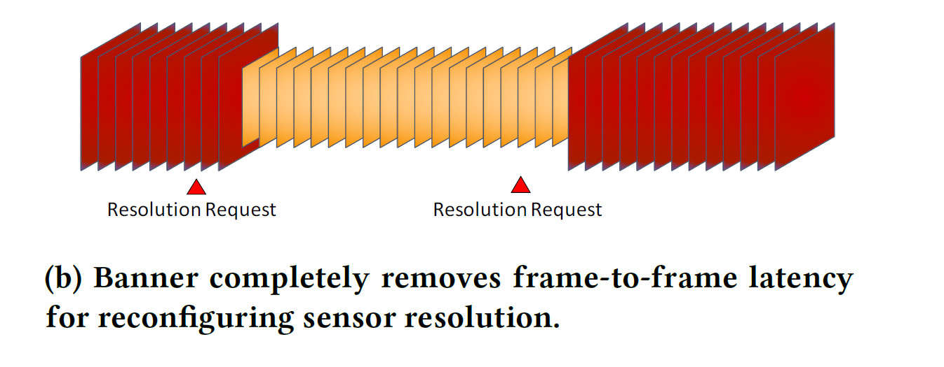
Solution: Banner Framework
Banner allows fast, seamless resolution changes without interruptions.
Uses two main techniques to speed up changes: parallel reconfiguration and format-oblivious memory management.
Parallel reconfiguration keeps the camera capturing while resolution changes in the background.
Format-oblivious memory management avoids memory resets, speeding up the switch.Banner eliminates frame drops and reduces reconfiguration time by over 50%.
Banner :An Image Sensor Reconfiguration Framework for Seamless Resolution-based Tradeoffs

Slide 5
Design of Banner
Purpose:
Banner enables fast, smooth resolution changes in the V4L2 framework
without frame drops.
Techniques:
Parallel Reconfiguration
Format-Oblivious Memory
Process:
Skips unnecessary steps (e.g., stopping/restarting streams).New resolution
frames appear immediately after processing frames from the previous
resolution.
Outcome:
Seamless, continuous multi-resolution video capture, reducing
reconfiguration delay by over 50%.
Banner :An Image Sensor Reconfiguration Framework for Seamless Resolution-based Tradeoffs

Slide 6
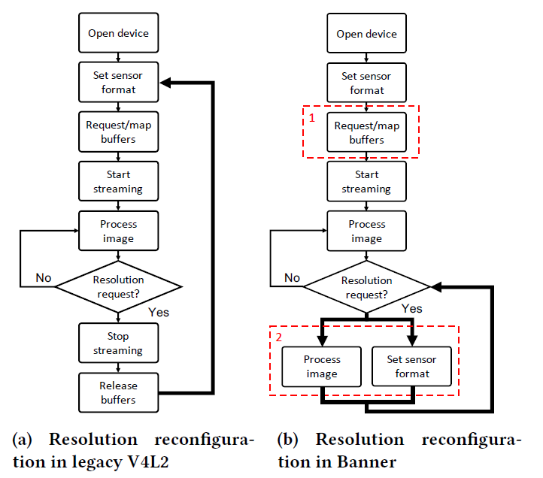
Figure 4: In Banner, most of the sequential procedures
are avoided for reconfiguring sensor resolution.
Banner :An Image Sensor Reconfiguration Framework for Seamless Resolution-based Tradeoffs

Slide 7
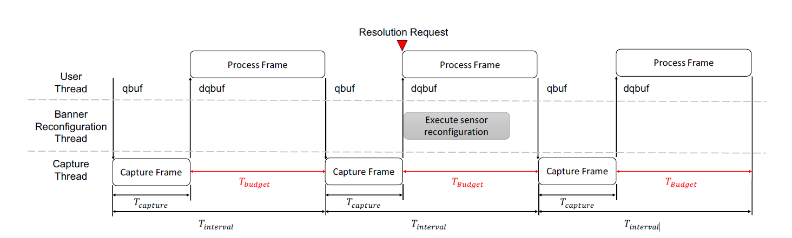
Parallel Reconfiguration
In current systems, resolution changes interrupt video capture.
Parallel reconfiguration in Banner allows changes in the background without stopping the video stream.
Resolution switches happen while the camera keeps capturing video.
Result: No visible pauses, so the video stream remains smooth.
Figure 5: Banner reconfigures sensor resolution in parallel with application processing frames in the reconfiguration timing budget (a function of frame interval and capture time) such that reconfiguration latency
can be hidden.
Banner :An Image Sensor Reconfiguration Framework for Seamless Resolution-based Tradeoffs

Slide 8
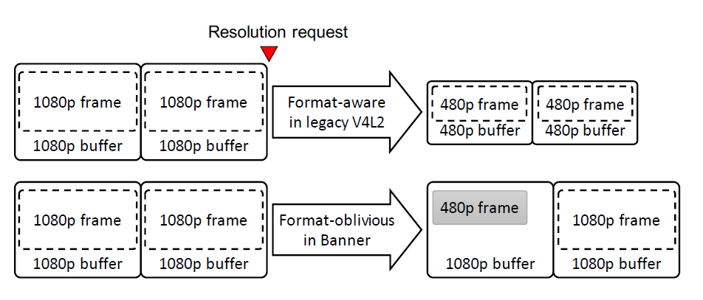
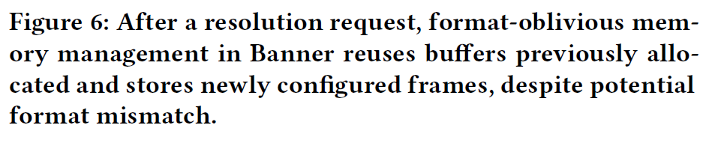
Format-Oblivious Memory Management
Typically, each resolution change needs memory to be reset, causing delays. Banner uses a flexible memory setup that works across different resolutions without resetting.
This setup avoids repeated memory allocation, speeding up resolution switching. Result: Faster, smoother transitions between resolutions.
Banner :An Image Sensor Reconfiguration Framework for Seamless Resolution-based Tradeoffs

Slide 9
Evaluation Results
Frame-to-Frame Latency: Reduced from 226 ms to 33 ms.
End-to-End Latency: Reduced by 54%, from 226 ms to 105 ms.
Power Savings: Up to 49% reduction when switching to lower resolutions.
Banner achieved seamless, fast resolution switching in all workloads.
Banner :An Image Sensor Reconfiguration Framework for Seamless Resolution-based Tradeoffs

Slide 10
Challenges and Future Work
Limitations:
Integration with Android requires driver modifications.
Future Directions:
Optimized memory management for frequent resolution changes.
Advanced algorithms for dynamic resolution selection.
Goal:
To further improve Banner’s efficiency and expand compatibility
Banner :An Image Sensor Reconfiguration Framework for Seamless Resolution-based Tradeoffs

Slide 11
Conclusion
Banner boosts mobile vision systems by making them faster and more energy-efficient.
Enables smooth, real-time resolution switching without interruptions or frame drops.
Key Benefits:
Cuts power use, improving battery life for continuous vision tasks.
Balances high image quality with energy efficiency, adapting to task needs.
Impact: Unlocks potential for energy savings and improved performance in mobile devices.
Banner :An Image Sensor Reconfiguration Framework for Seamless Resolution-based Tradeoffs

Slide 12
THANK YOU
Banner :An Image Sensor Reconfiguration Framework for Seamless Resolution-based Tradeoffs

